Slide 1
A class survey Project
A. What are you like? Complete questions 1 to 5 using the words in the box. Then write your answers to the questions in the table.
are do have married old
How old are you?
Where are you from?
Are you married or single?
Do you have a job? (If yes, what is it?)
Do you have a cell phone? (If yes, what kind?)
have
Do
 | 1. Age? | 2. Hometown? | 3. Relationship? | 4. Job? | 5. Phone?
You
Partner 1
Partner 2
Partner 3
Partner 4

Slide 2
A class survey Project
B. Work in a group of five people. Take turns. Tell everyone in the group your answers. Together, make one chart with everyone’s answers.
C. Share your results. Put your chart on the board.
D. Make a poster. With your group, read all the charts on the board. Make a poster about a typical person in your class.
E. Show your poster to another group. Tell them about it. Are your posters the same?
I am years old.
I am from .
I am single/married.
I have/don’t have a job.
I have/don’t have a cell phone.
Language Note

Slide 3
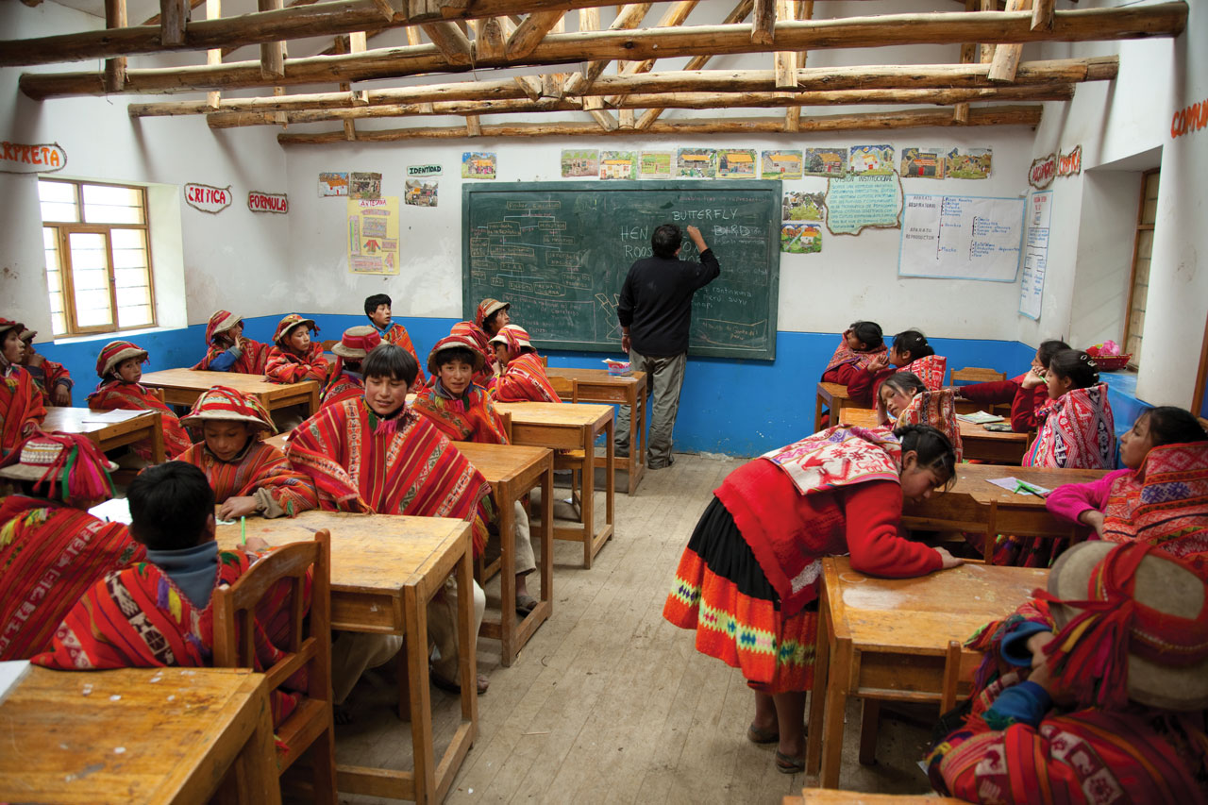
A class survey Project
Make a new survey. Choose a particular group of people in your country (e.g., business people, retired people, or young children). Make a survey and interview them. What is a typical person in that group like? Share your results with the class.
Students in a language class in Peru

